Slide 1
TREVONE VILLAGE HALL
Before DURING & AFTER THE REBUILD

Slide 2
The hall in 1922
It was converted from a calf shed to a Men’s Club.

Slide 3
The front hall
In the 1970s many villagers worked hard to convert the hut into a larger hall foR the community.

Slide 4
The back hall
Converted from an old Nissen Hut with its asbestos roof but over the years its condition declined.

Slide 5
Crumbling windows

Slide 6
Damp and rotting doors

Slide 7
The Plan!

Slide 8
Interior Plan

Slide 9
The Fundraising!
The plans were drawn and the original quote saw a projected cost of £250,000 no small task…….
And of course over the years the cost escalated……to over £300,000

Slide 10
Fundraising
Bacon Roll mornings first Sunday of every month

Slide 11
Fundraising
Dinner at Cornish Arms, one of two with the meal donated by Steins and Auction items from local businesses, big and small

Slide 12
Fundraising
Supper evenings, one held most months bringing the community together and fundraising

Slide 13
Fundraising
Cream Teas

Slide 14
Fundraising Raffles with wonderful support from local businesses and individuals

Slide 15
Fundraising
Ukelele band playing at the Beach Cafe

Slide 16
Fundraising
An outdoor Ceilidh with the Cataclews

Slide 17
Fundraising
Summer BBQs

Slide 18
Fundraising – from sponsored litter picking to preloved clothes sales!

Slide 19
And finally
January 2024 the build begins with site clearance

Slide 20
The Rebuild
February 2024The asbestos roof is gone, now for the walls and old base

Slide 21
The Rebuild
Demolition continues

Slide 22
The Rebuild
March 2024, the concrete is poured

Slide 23
The Rebuild
And the footings are done

Slide 24
The Rebuild
April 2024
We hit a problem, the side wall is badly cracked and leaning. Work halts while a solution is found and costed…..

Slide 25
The Rebuild
May 2024
The walls go up.

Slide 26
The Rebuild
June 2024
A solution is found for the wall and fundraising continues to raise the extra cash!

Slide 27
Fundraising Continues at different venues, private houses, The Well Parc, the WI Hall…..

Slide 28
The Rebuild
July 2024
The roof takes shape

Slide 29
The Rebuild
July 2024
The inside takes shape

Slide 30
The Rebuild
The trusses are all on!

Slide 31
The Rebuild
September 2024
Roofing begins

Slide 32
The Rebuild
October 2024
The roof is on!

Slide 33
The Rebuild
October 2024
The new hall is watertight so first fix begins

Slide 34
The Rebuild
December 2024
The floor is down, the walls plastered.

Slide 35
The Rebuild
January 2025
External Cladding

Slide 36
Completion
March 2025
Final external and internal works take place ready for handover on the 1st April 2025

Slide 37
The Clean Up
April 2025 the community come together to move tables and chairs to the new hall and clean up!

Slide 38
The Clean Up

Slide 39
The First Coffee Morning
Throughout the build coffee mornings continued in different houses in the village now its back in the hall, an important part of the village life.

Slide 40
The First Event
An art exhibition by a local resident and a cream teas afternoon by the hall committee
The first of many such events in our beautiful new community hub

Slide 41
Saturday 10th May 2025 The Official Opening

Slide 42
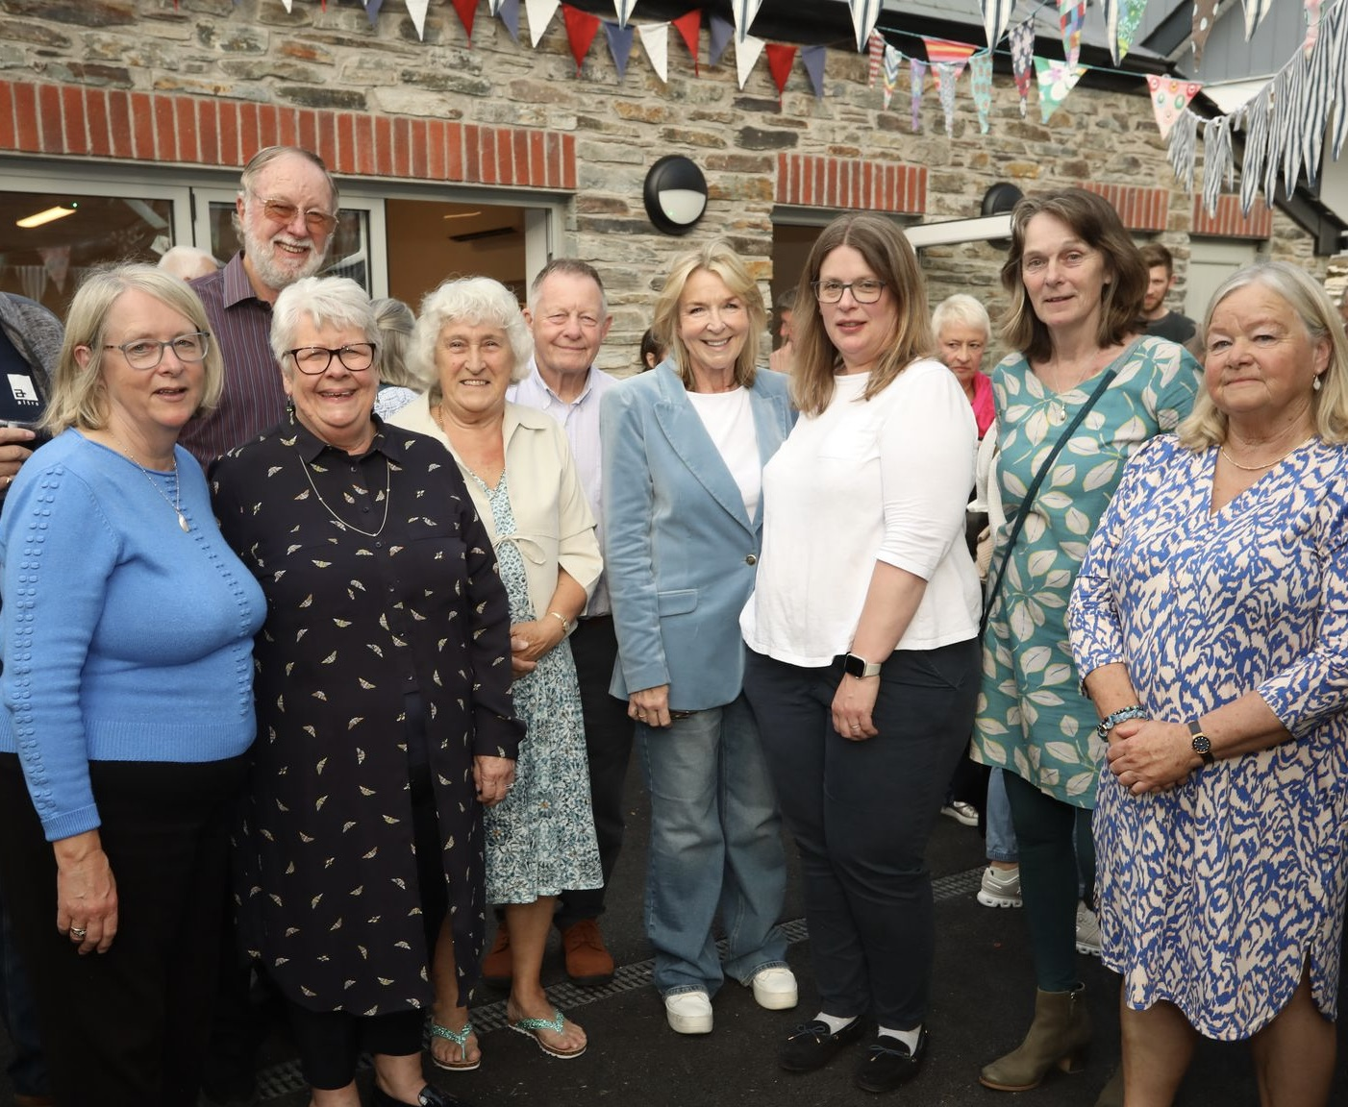
THANK YOU
None of this could have happened without the dedication and support of the Trustees of the hall, past and present, the community of Trevone, full time and visitors, donations from local businesses including but not exclusively Steins, The Pig, The Beach Café, The Shop Trevone, Chough Bakery, funding from Padstow Council, CLUP, Garfield Weston, Bernard Sunley, WREN and donations from individuals too numerous to mention.

